Slide 1

Project 3 – Jurassic Park

Slide 2
Delta Clock
Problem: How to efficiently monitor timed events?
Examples of timed events:
scheduling
real-time sequencing
timers
timeouts
Lists require each event to be examined to determined if time has expired.

Slide 3
DC Implementation
Notice that Event1 occurs 15 tics after Event2
Suppose:
Event1 occurs in 20 tics
Event2 occurs in 5 tics
Event3 occurs in 35 tics
Event4 occurs in 27 tics
Event 5 occurs in 27 tics
Event 6 occurs in 22 tics
20
Event1
5
Event2
5
Event2
35
Event3
12
Event7
5
Event2
3
Event1
12
Event7
5
Event2
27
Event4
2
Event6
3
Event1
15
Event1
5
Event4
2
Event6
2
Event6
27
Event5
0
Event5
5
Event4
5
Event4
And that Event6 occurs 2 tics after Event1
4
Event8
0
Event5
0
Event5
4
Event3
22
Event6
8
Event3
8
Event3
Linked List
Delta Clock
What if Event7 occurs in 17 tics?
Event8 in 31 tics?

Slide 4
Project 3 – Jurassic Park
Contemporary operating systems are built around the concept of processes or tasks. These tasks usually need to share resources in a protected, prioritized, and equitable manner.
Jurassic Park is a inter-process communication and synchronization problem between multiple tasks.
Visitors, drivers, and cars are represented by concurrent tasks while additional tasks display the park status and check for any lost visitors.
A poorly implemented solution could lead to the inter-process communication problems of starvation and deadlock.

Slide 5
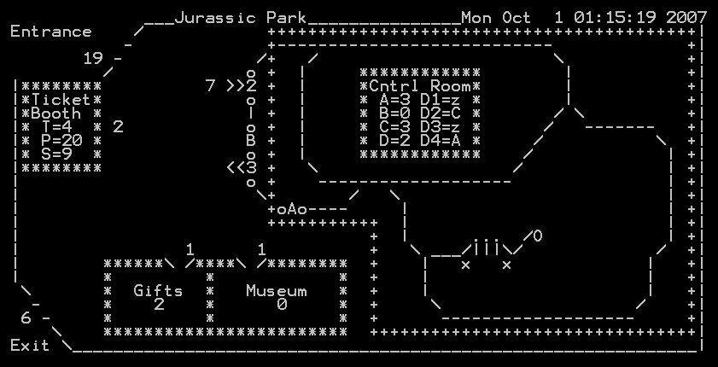
Jurassic Park
Visitors try to enter the Jurassic Park at random times. (Only a set number of visitors may be in the park at any one time – OSHA requirements!)
When the touring car is filled with visitors and a driver is obtained, the car enters Jurassic Park and runs a guided tour through the park.
Upon being allowed in the park, a visitor must get in line to purchase a ticket.
When the tour car pulls into the unloading station, the visitors exit the tour car. and the driver goes to sleep awaiting new duties. The tour car pulls forward to be loaded again.
After visiting the museum, the visitor gets in the tour car line to wait until permitted to board a tour car. (As a visitor boards a tour car, he returns his ticket.)
After successfully obtaining a ticket from a driver, the visitor gets in the museum line and visits the museum. (A limited number of visitors are allowed in the museum as well as the gift shop.)
After the visitors exit a tour car, they get into the gift shop line until they can visit the gift shop.
After visiting the gift shop, the visitors exit the park.

Slide 6
Project 3 – Guidelines…
You may use the arguments to the project3 command to optionally specify the number of park visitors, in multiples of 3. (The default is 45 visitors.)
Add a delta clock to your operating system. The delta clock ticks in tenth-of-a-second increments.
Create a task for each park visitor (NUM_VISITORS), driver (NUM_DRIVERS), and tour car (NUM_CARS). These tasks should all run at the same priority level.
Update the park data structure variables appropriately as visitor, driver, and car states change. The park is displayed using the park data struct every second by the jurassicTask task.

Slide 7
Project 3 – Guidelines…
Each task (visitor, driver, and car) should create its own timing semaphore, which is used for timing functions (ie, arrival delay, standing in lines, time in gift shop or museum.) The delta clock should be used to SEM_SIGNAL these semaphores.
Park visitors should randomly arrive at the park over a 10 second period. In addition, visitors should stand in lines for a random time before requesting a ticket or entrance to the museum or gift shop (3 seconds maximum).

Slide 8
Project 3 – Guidelines…
Use resource semaphores (counting) to control access to the park, the number of tickets available, and the number of people allowed in the gift shop and museum.
Use mutex semaphores (binary) to protect any critical sections of code within your implementation, such as when updating the delta clock, acquiring a driver to buy a ticket or drive a tour car, accessing global data, or sampling the state of a semaphore.
Use semaphores (binary) to synchronize and communicate events between tasks, such as to awaken a driver, signal data is valid, signal a mode change, etc.

Slide 9
Project 3 – Guidelines…
Use at least one SEM_TRYLOCK function in your simulation.
The “SWAP” directive should be inserted between every line of code in your Jurassic Park simulation. Park critical code must be protected by the parkMutex mutex.
The park simulation creates a “lostVisitor” task which sums critical variables in the park to detect any lost visitors. Beware!
You are to implement a fair algorithm that prevents deadlock and starvation rather than detect them

Slide 10
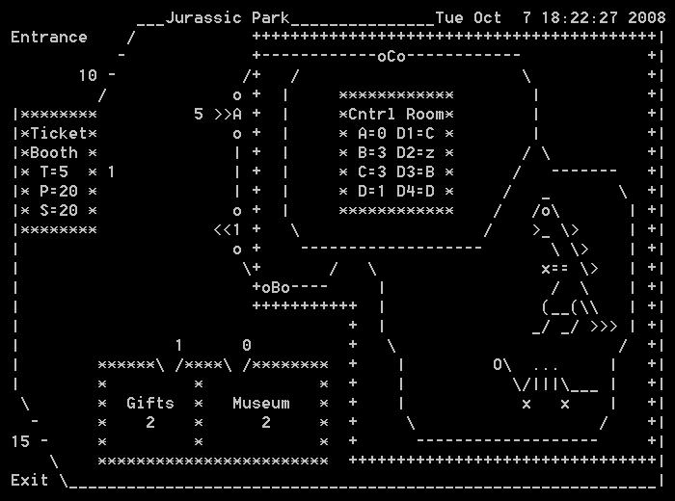
Jurassic Park struct
# Waiting to Enter Park
numOutsidePark
Tour Car Line
numInCarLine
# of Passengers
park.cars[ ].passengers
Ticket Line
numInTicketLine
Driver Status
park.drivers[ ]
# Tickets Available
numTicketsAvailable
# in Park
numInPark
# Rides Taken
numRidesTaken
# Exited Park
numExitedPark
# in Gift Shop
numInGiftShop
Gift Shop Line
numInGiftLine
# in Museum
numInMuseum
Museum Line
numInMuseumLine

Slide 11
Semaphores
Use resource semaphores (counting) to control access to the park, the number of tickets available, and the number of people allowed in the gift shop and museum.
// create MAX_TICKETS tickets using counting semaphore
tickets = createSemaphore("tickets", COUNTING, MAX_TICKETS);
SWAP;
// buy a ticket (consume)
SEM_WAIT(tickets); SWAP;
// resell ticket (produce)
SEM_SIGNAL(tickets); SWAP;

Slide 12
Semaphores
Use mutex semaphores (binary) to protect any critical sections of code, such as when updating the delta clock, acquiring a driver to buy a ticket or drive a tour car, accessing global data, or sampling the state of a semaphore.
// need ticket, wait for driver (mutex)
SEM_WAIT(needDriverMutex); SWAP;
{
// signal need ticket (signal, put hand up)
…
}
// release driver (mutex)
SEM_SIGNAL(needDriverMutex); SWAP;

Slide 13
Semaphores
Use signal semaphores (binary) to synchronize and communicate events between tasks, such as to awaken a driver, signal data is valid, etc.
// signal need ticket (signal, put hand up)
SEM_SIGNAL(needTicket); SWAP;
{
// wakeup driver (signal)
SEM_SIGNAL(wakeupDriver); SWAP;
// wait ticket available (signal)
SEM_WAIT(ticketReady); SWAP;
// buy ticket (signal)
SEM_SIGNAL(buyTicket); SWAP;
}
// put hand down (signal)
SEM_WAIT(needTicket); SWAP;

Slide 14
Shared Memory
Shared memory can be implemented using C global memory when protected with mutex semaphores.
// protect shared memory access
SEM_WAIT(parkMutex); ;SWAP
// access inside park variables
myPark.numOutsidePark--; ;SWAP
myPark.numInPark++; ;SWAP
// release protect shared memory access
SEM_SIGNAL(parkMutex); ;SWAP

Slide 15
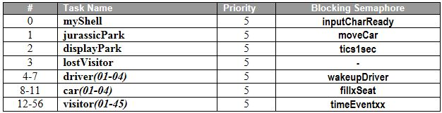
Project 3 – Jurassic Park
3 points – Implement a delta clock in the pollInterrupts routine (OS345.c) that should tick down every 1/10 of a second.
2 points – Create a single, re-entrant visitor task that enters the Jurassic Park at random times, purchases a ticket, visits the museum, takes a tour of the park, stops by the gift shop, and then exits the park.
1 point – Create a single, re-entrant car task the acquires 3 visitors and a driver while touring the park.
1 point – Create a single, re-entrant driver task, which sleeps until awakened to sell a ticket or drive a tour car.
1 point – Correctly use resource, mutex, and synchronization semaphores in your implementation.
2 points – P3 starts a fully functional jurassicTask.

Slide 16
Project 3 – Jurassic Park
In addition to the possible 10 points, the following bonus/penalties apply:
+1 point – bonus for early pass-off (at least one day before due date.)
+1-4 points – bonus for approved changes to os345park.c, such as:
Improved interface to park
Different routes in park
Making dinosaurs individual tasks
Random lost (or consumed) park visitors (must be accounted for)
Gift shop expenditures
Having drivers do periodic maintenance on park ride
Something you think is clever…
-1 point – penalty for not running visitor, car, and driver tasks at same priority level.
-1 point – penalty for altering os345park.c without approval.
-10 points – penalty for not having a SWAP after every C line of code.
-1 point – penalty for each school day late.

Slide 17
Step 1: Delta Clock
Project 3 Assignment
Implement delta clock.
Design data structure to hold delta times/events.
Program an insert delta clock function
insertDeltaClock(int time, Semaphore* sem);
High priority, mutex protected
Add 1/10 second function to decrement top event and semSignal semaphore when 0
pollinterrupts or
High priority, mutex protected.
dc[5]
dc[4] | 10 / sem1
dc[3] | 5 / sem2
dc[2] | 0 / sem3
dc[1] | 2 / sem4
dc[0] | 4
Thoroughly test the operation of your delta clock before proceeding.
os345p3.c
Print Delta Clock (dc): int P3_dc(int argc, char* argv[]);
Test Delta Clock (tdc): int P3_tdc(int argc, char* argv[]);
int dcMonitorTask(int argc, char* argv[]);
int timeTask(int argc, char* argv[]);

Slide 18
Step 2: Car Tasks
Project 3 Assignment
Implement simple car task.
Design car functionality and Jurassic Park interface. (Don’t worry about passengers or drivers yet.)
Semaphore* fillSeat[NUM_CARS]; SWAP;
Semaphore* seatFilled[NUM_CARS]; SWAP;
Semaphore* rideOver[NUM_CARS]; SWAP;
Action | Car Task |  | Park Task
For each car seat: (3 times, then car takes off) | SEM_WAIT(fillSeat[carID]); Get passenger Save passenger rideDone[] semaphore Get driver (if last passenger) Save driver driverDone semaphore SEM_SIGNAL(seatFilled[carID]); | ← → | SEM_SIGNAL(fillSeat[carID]); SEM_WAIT(seatFilled[carID]);
Wait until ride over | SEM_WAIT(rideOver[carID]); | ← | SEM_SIGNAL(rideOver[carID]);
Release driver | SEM_SIGNAL(driverDone);
Release passengers | SEM_SIGNAL(rideDone[i]);
***Temporarily add the following to get the cars moving:
myPark.numInCarLine = myPark.numInPark = 4;

Slide 19
Step 2: Car Tasks (example)
Project 3 Assignment
// For each car, do 3 times:
{ SEM_WAIT(fillSeat[carID]); SWAP; // wait for available seat
SEM_SIGNAL(getPassenger); SWAP; // signal for visitor
SEM_WAIT(seatTaken); SWAP; // wait for visitor to reply
... save passenger ride over semaphore ...
SEM_SIGNAL(passengerSeated); SWAP: // signal visitor in seat
// if last passenger, get driver
{
SEM_WAIT(needDriverMutex); SWAP;
// wakeup attendant
SEM_SIGNAL(wakeupDriver); SWAP;
... save driver ride over semaphore ...
// got driver (mutex)
SEM_SIGNAL(needDriverMutex); SWAP;
}
SEM_SIGNAL(seatFilled[carID]); SWAP; // signal next seat ready
}
SEM_WAIT(rideOver[myID]); SWAP; // wait for ride over
... release passengers and driver ...

Slide 20
Step 3: Visitor Tasks
Project 3 Assignment
Design visitor functionality and car task interface. (Don’t worry about tickets yet.)
Each task visitor should create its own timing semaphore, which is used for timing functions (ie, arrival delay, standing in lines, time in gift shop or museum.) The delta clock should be used to SEM_SIGNAL these semaphores.
Park visitors should randomly arrive at the park over a 10 second period. In addition, visitors should stand in lines for a random time before requesting a ticket or entrance to the museum or gift shop (3 seconds maximum).
The “SWAP” directive should be inserted after every line of code in your Jurassic Park simulation. Park critical code must be protected by the parkMutex mutex.
The park simulation creates a “lostVisitor” task which sums critical variables in the park to detect any lost visitors.

Slide 21
Step 3: Visitor Tasks
Project 3 Assignment
Use resource semaphores (counting) to control access to the park, the number of tickets available, and the number of people allowed in the gift shop and museum.
Use mutex semaphores (binary) to protect any critical sections of code within your implementation, such as when updating the delta clock, acquiring a driver to buy a ticket or drive a tour car, accessing global data, or sampling the state of a semaphore.
Use semaphores (binary) to synchronize and communicate events between tasks, such as to awaken a driver, signal data is valid, signal a mode change, etc.

Slide 22
Semaphores
Use resource semaphores (counting) to control access to the park, the number of tickets available, and the number of people allowed in the gift shop and museum.
// create MAX_TICKETS tickets using counting semaphore
tickets = createSemaphore("tickets", COUNTING, MAX_TICKETS);
SWAP;
// buy a ticket (consume)
SEM_WAIT(tickets); SWAP;
// resell ticket (produce)
SEM_SIGNAL(tickets); SWAP;

Slide 23
Semaphores
Use mutex semaphores (binary) to protect any critical sections of code, such as when updating the delta clock, acquiring a driver to buy a ticket or drive a tour car, accessing global data, or sampling the state of a semaphore.
// need ticket, wait for driver (mutex)
SEM_WAIT(needDriverMutex); SWAP;
{
// signal need ticket (signal, put hand up)
…
}
// release driver (mutex)
SEM_SIGNAL(needDriverMutex); SWAP;

Slide 24
Semaphores
Use signal semaphores (binary) to synchronize and communicate events between tasks, such as to awaken a driver, signal data is valid, etc.
// signal need ticket (signal, put hand up)
SEM_SIGNAL(needTicket); SWAP;
{
// wakeup driver (signal)
SEM_SIGNAL(wakeupDriver); SWAP;
// wait ticket available (signal)
SEM_WAIT(ticketReady); SWAP;
// buy ticket (signal)
SEM_SIGNAL(buyTicket); SWAP;
}
// put hand down (signal)
SEM_WAIT(needTicket); SWAP;

Slide 25
Shared Memory
Shared memory can be implemented using C global memory when protected with mutex semaphores.
// protect shared memory access
SEM_WAIT(parkMutex); ;SWAP
// access inside park variables
myPark.numOutsidePark--; ;SWAP
myPark.numInPark++; ;SWAP
// release protect shared memory access
SEM_SIGNAL(parkMutex); ;SWAP

Slide 26
Passing Semaphores
Shared memory can be implemented using C global memory when protected with mutex semaphores.
// pass semaphore to car (1 at a time)
SEM_WAIT(mailboxMutex); SWAP; // wait for mailbox
SEM_WAIT(needPassenger); SWAP: // wait for passenger request
gMailbox = mySemaphore; SWAP; // put semaphore in mailbox
SEM_SIGNAL(mailboxReady); SWAP; // raise the mailbox flag
SEM_WAIT(mailAcquired); SWAP; // wait for delivery
SEM_SIGNAL(mailboxMutex); SWAP; // release mailbox
// get passenger semaphore
SEM_SIGNAL(needPassenger); SWAP;
SEM_WAIT(mailboxReady); SWAP; // wait for mail
mySemaphore = gMailbox; SWAP; // get mail
SEM_SIGNAL(mailAcquired); SWAP; // put flag down

Slide 27
Jurassic Park struct
# Waiting to Enter Park
numOutsidePark
Tour Car Line
numInCarLine
# of Passengers
park.cars[ ].passengers
Ticket Line
numInTicketLine
Driver Status
park.drivers[ ]
typedef struct
{
int numOutsidePark; // # outside of park
int numInPark; // # in park (P=#)
int numTicketsAvailable; // # left to sell (T=#)
int numRidesTaken; // # of tour rides taken (S=#)
int numExitedPark; // # who have exited the park
int numInTicketLine; // # in ticket line
int numInMuseumLine; // # in museum line
int numInMuseum; // # in museum
int numInCarLine; // # in tour car line
int numInCars; // # in tour cars
int numInGiftLine; // # in gift shop line
int numInGiftShop; // # in gift shop
int drivers[NUM_DRIVERS]; // driver state (-1=T, 0=z, 1=A, 2=B, etc.)
CAR cars[NUM_CARS]; // cars in park
} JPARK;
# Tickets Available
numTicketsAvailable
# in Park
numInPark
# Rides Taken
numRidesTaken
# Exited Park
numExitedPark
# in Gift Shop
numInGiftShop
Gift Shop Line
numInGiftLine
# in Museum
numInMuseum
Museum Line
numInMuseumLine

Slide 28
Step 4: Driver Tasks
Project 3 Assignment
Develop the driver task.
Design driver functionality and interface with visitor/car tasks.
Implement design and integrate with os345, visitor, and car tasks. (Now is the time to worry about ticket sales and driver duties.)
Add ticket sales and driver responsibilities.
When a driver is awakened, use the semTryLock function to determine if a driver or a ticket seller is needed.

Slide 29
Driver Task
Project 3 Assignment
int driverTask(int argc, char* argv[])
{
char buf[32];
Semaphore* driverDone;
int myID = atoi(argv[1]) - 1; SWAP; // get unique drive id
printf(buf, "Starting driverTask%d", myID); SWAP;
sprintf(buf, "driverDone%d", myID + 1); SWAP;
driverDone = createSemaphore(buf, BINARY, 0); SWAP; // create notification event
while(1) // such is my life!!
{
mySEM_WAIT(wakeupDriver); SWAP; // goto sleep
if (mySEM_TRYLOCK(needDriver)) // i’m awake - driver needed?
{ // yes
driverDoneSemaphore = driverDone; SWAP; // pass notification semaphore
mySEM_SIGNAL(driverReady); SWAP; // driver is awake
mySEM_WAIT(carReady); SWAP; // wait for car ready to go
mySEM_WAIT(driverDone); SWAP; // drive ride
}
else if (mySEM_TRYLOCK(needTicket)) // someone need ticket?
{ // yes
mySEM_WAIT(tickets); SWAP; // wait for ticket (counting)
mySEM_SIGNAL(takeTicket); SWAP; // print a ticket (binary)
}
else break; // don’t bother me!
}
return 0;
} // end driverTask
Should this
be mutexed?

Slide 30
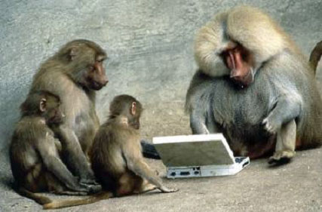
Notes:
Paul Roper
30

Slide 31
Suggested Implementation Steps
1. Implement delta clock.
a. Design data structure to hold delta times/events.
b. Add 1/10 second routine to pollinterrupts. Decrement top event and semSignal when time = 0.
c. Program an insert delta clock routine (insertDeltaClock(int time, Semaphore* sem)).
d. Thoroughly test the operation of your delta clock before proceeding.
2. Develop the car task.
a. Design car functionality and Jurassic Park interface. (Don’t worry about passengers yet.)
b. Implement design and integrate with os345 and Jurassic Park.
c. Observe correct car behavior.

Slide 32
Suggested Implementation Steps
3. Develop the visitor task.
a. Design visitor functionality and car task interface.
b. Implement design and integrate with os345 and car tasks. (Don’t worry about tickets yet.)
c. Use delta-clock to vary visitor time in all lines, museum, and gift shop.
d. Observe correct visitor behavior as a visitor moves through the park.
4. Develop the driver task.
a. Design driver functionality and interface with visitor and car tasks.
b. Implement design and integrate with os345, visitor, and car tasks. (Now is the time to worry about ticket sales and driver duties.)
c. Add ticket sales and driver responsibilities.
d. When a driver is awakened, use the semTryLock function to determine if a driver or a ticket seller is needed.

Slide 33
Notes:
Paul Roper
33

